Slide 1
DETECTION, LOCALISATION and TRACKING

Slide 2
Object Recognition vs. Object Detection
Object detection and object recognition are similar techniques for identifying objects, but they vary in their execution. Object detection is the process of finding instances of objects in images. In the case of deep learning, object detection is a subset of object recognition, where the object is not only identified but also located in an image. This allows for multiple objects to be identified and located within the same image.

Slide 3

.

Slide 4
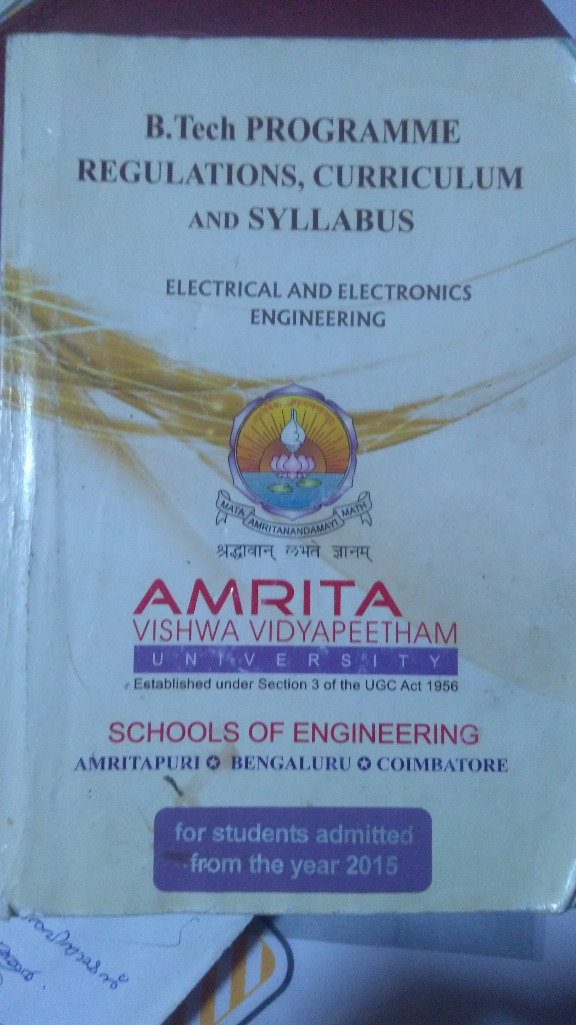

Feature extraction

